Slide 1
Group 3 – FCEPH
Team Project
Anis Subba - Jennifer Odongo - Benjamin Mapamboli - Nazir Mohammmad
https://github.com/AKLBeast/AKLbeast-

Slide 2

Introduction
In this project we are required to develop a project as group of four.
Define our group ad roles
Looking at different and necessary factors and elements required in this project.
The aim is to engage in a collaborative team
The idea is to develop an integrated information system for a supermarket.

Slide 3
FCEPH | Review of Roles - Anis
Non-Technical Role – Project Manager
Taking minutes
Creating the project plan
Contribution to Development
Creating the page with the list of items

Slide 4
FCEPH | Review of Roles - Jennifer
Non-Technical Role – Documenter
Documenting everything
Work Breakdown Structure
Overall Project Lifecycle
Contribution to Development
Login page

Slide 5
FCEPH | Review of Roles - Benjamin
Non-Technical Role – Quality Assurance
Checking the quality of work produced by the team
Risk Register
Contribution to Development
Creating a database

Slide 6
FCEPH | Review of Roles - Nazir
Non-Technical Role – Integration
Planning how the extra components will be integrated into the core software
Contribution to Development
Creating the page with the items information

Slide 7
FCEPH | Project Plan
Our project objective is to create an application and website for the supermarket. To accomplish this we created a project plan. This helps us set guidelines and create structure to our project and team.
Our project plan contains:
A definition of everyone's roles
An outlining of what software and resources are used
A weekly work schedule
The supermarket name
The colour scheme. Green, Blue and White
The logo
Etc.

Slide 8
FCEPH | Project Plan
Core Requirements
Login/Register Page
Delivery Page
Customers should be able to log in or register.
Products Page
Checkout Page
Customers should be able to choose a delivery date for their items.
Customers should be able to view the items available.
Item Page
Basket Page
Customers should be able to checkout items in their basket.
Customers should be able to select items and view a detailed description.
Customers should be able to add items to basket.

Slide 9
FCEPH | Project Plan

Slide 10
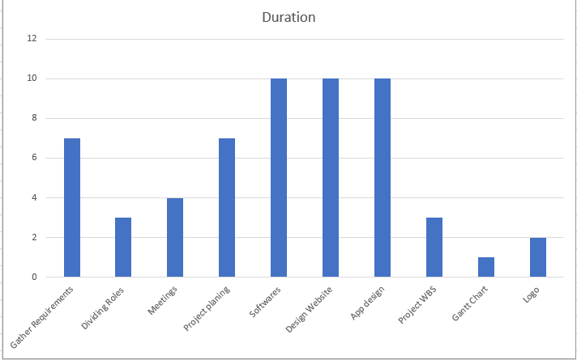
FCEPH | Project Plan | Gantt Chart

Slide 11
FCEPH | Progress - Week 1&2

Slide 12
FCEPH | Progress – Week 3&4

Slide 13
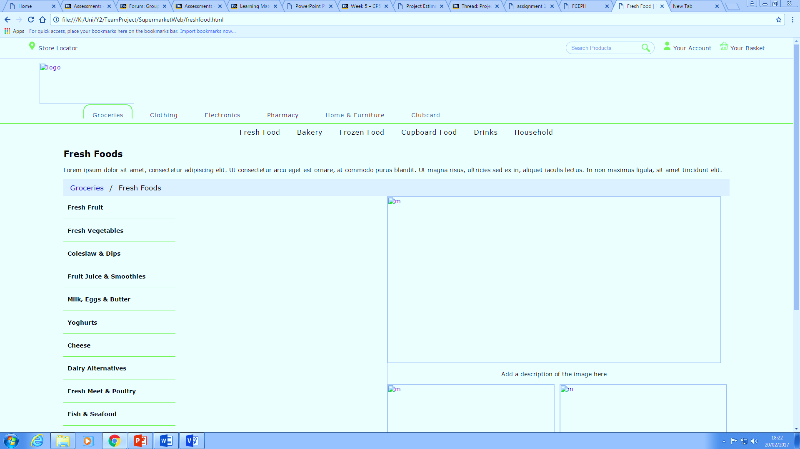
FCEPH | Progress – Week 5

Slide 14
FCEPH | Conclusion - Future Progress
This module give us the experience of team work.
Perform individual work and participate in collective tasks

Slide 15
Any Questions?

